Slide 1


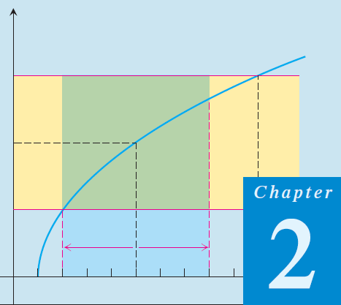
Thomas Calculus 11th
03
Limits and Continuity
Samuel Lukas

Slide 2
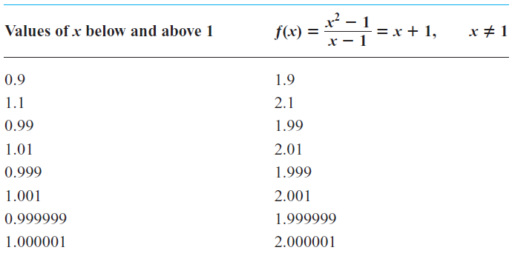
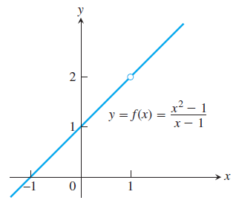
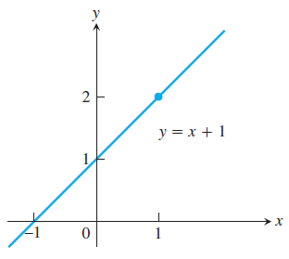
Introduction Limit
Limit of f(x) as x approaches a is L, written as

Slide 3
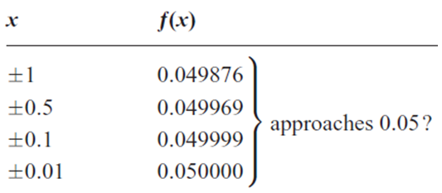
Example 1
Compute the value of

Slide 4

The Concept
Prove that :

Slide 5
Limit Theorem
This theorem is used to show a limit does not exist.
For the function
But

Slide 6


Limit Laws

Slide 7
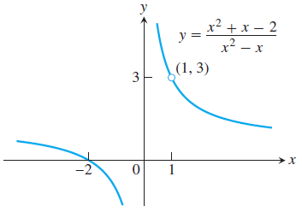








Example 2

Slide 8
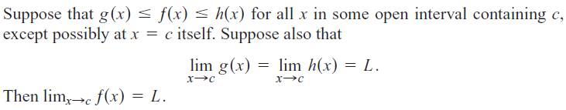

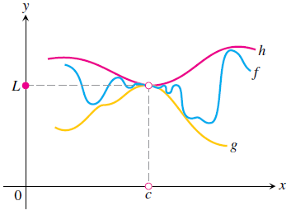

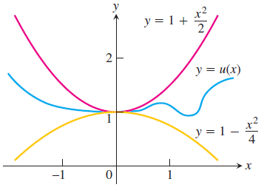
The Sandwich Theorem

Slide 9
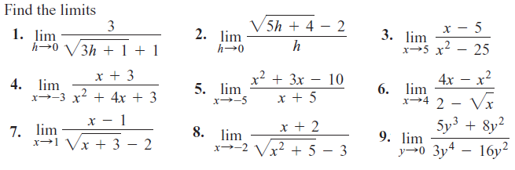
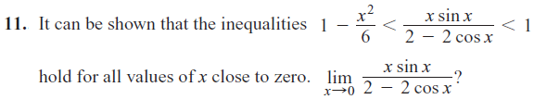
Exercise 1

Slide 10
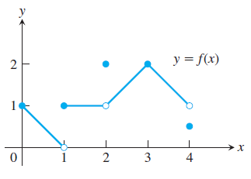
Introduction Continuity

Slide 11
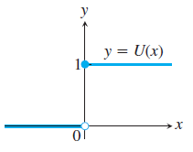

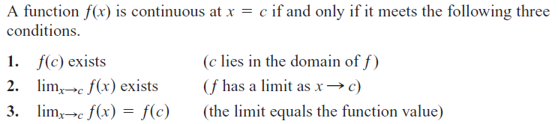
Definition
A function is continuous on an interval if and only if it is continuous at every point of the interval.

Slide 12

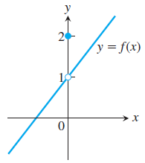
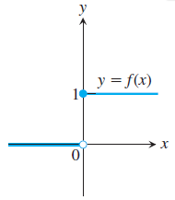
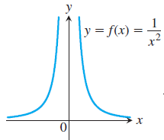
Types of Discontinuity

Slide 13
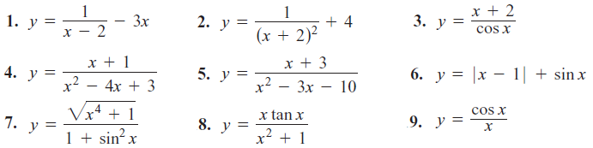
Exercise 2
At what points are the functions in Exercises 1 – 9 continuous?

Slide 14
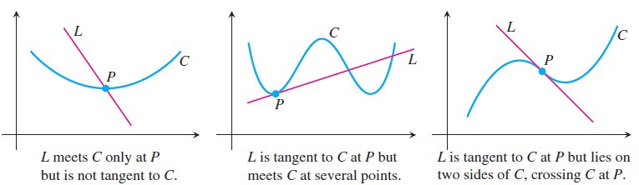
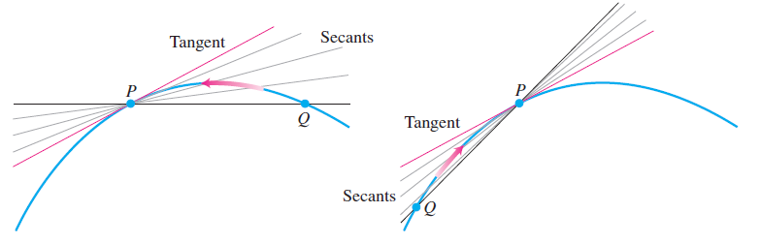
Tangens Line
Generalizing, we might say that it means one of the following:
1. L passes through P perpendicular to the line from P to the center of C.
2. L passes through only one point of C, namely P.
3. L passes through P and lies on one side of C only.

Slide 15
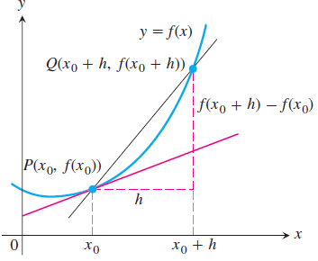

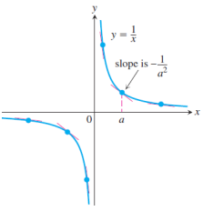

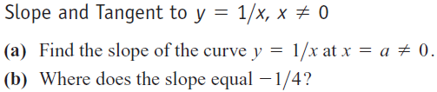

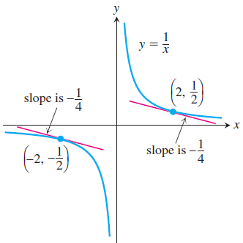

Slope of The Tangen Line

